Slide 1
ENVIRONMENT
CHAPITER 4

Slide 2
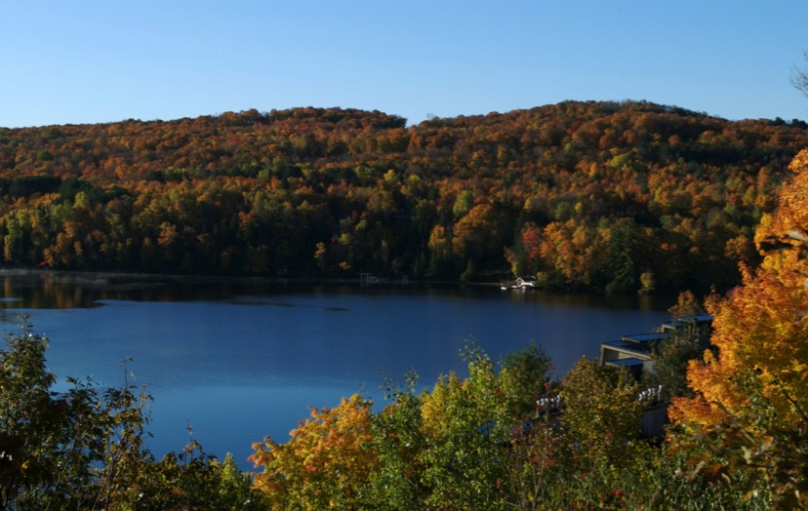
Celebrating environment
Notes:
Several years ago my wife, Janet, and I began searching for a country cabin to purchase for weekend retreats. North of Toronto in the Muskoka District we found some beautiful turquoise lakes. We were deeply impressed and admired their tropical colors, only to be told that the lakes were “dead.” Acid rain, caused by industrial pollution of the atmosphere, had acidified the water to such a degree that the lakes were devoid of flora and fauna. Beautiful to look at but toxic for any kind of life within them, such lakes have become sterile.

Slide 3

Environmental awareness
Notes:
Life can flourish only in a suitable environment; it requires an appropriate balance of climate, water, soil, and air.
The physical, chemical, and biotic factors that surround us, such as air, temperature, sun, soil, and water—as well as the flora and fauna—compose our “environment.” Health requires a sustaining and supportive environment, and many of our practices undermine this support and sustainability.

Slide 4
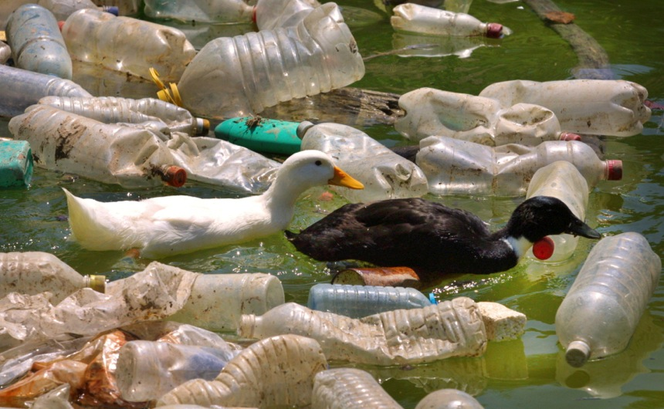
Pollution of water
Notes:
Pollution of water and air, destruction of natural habitats, and massive industrialization threaten the continuation of life as we know it; therefore, environmental awareness is important to the maintenance of health.

Slide 5
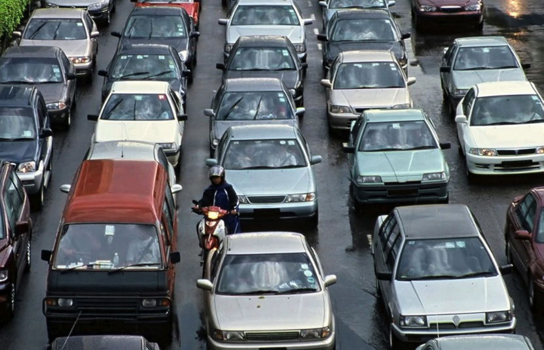
Now we use lead-free gasoline
Notes:
Fifty years ago lead poisoning was relatively common. Physicians were taught to recognize discoloration of gums, bluish stippling in blood cells, and the sight of neurotoxic damage caused by lead. Lead was added to paint to give it luster and strength, but children would pick at flaking paint, eat the flakes, and become poisoned by the lead content. Gasoline contained lead to augment its properties with resultant increased atmospheric lead that could be inhaled and therefore poison the populace. Recognition of the cause of a problem often leads to a resolution, as in the now ubiquitous production of lead-free gasoline.

Slide 6
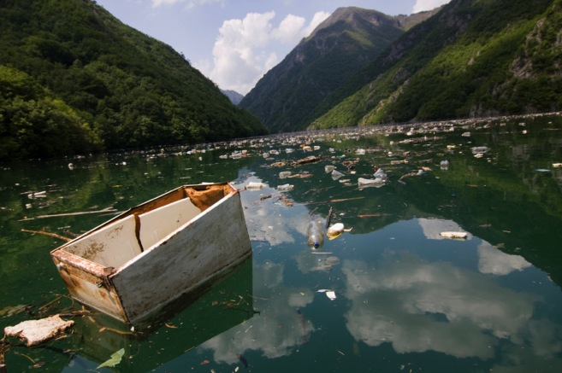
When multiplied by millions, they begin to have a major destructive effect
Notes:
A little pollution here, destruction of a few trees there, the dumping of some raw sewage into a river somewhere—all these may seem of small impact. When such isolated acts are multiplied by millions, however, they begin to have a major destructive effect.

Slide 7








Overpopulation: an environmental concern?
Notes:
It’s for this reason that many people are beginning to voice what has sometimes been labeled a “politically incorrect” viewpoint: that overpopulation is the worst environmental threat we are faced with today.

Slide 8
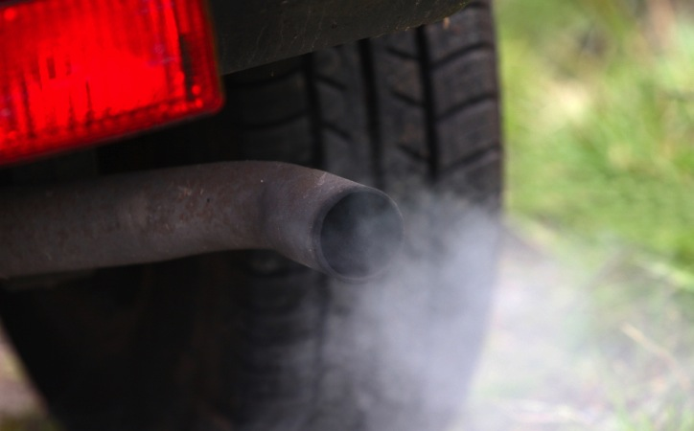
A single automobile may emit insignificant pollutants
Notes:
A single automobile may emit what would be insignificant pollutants if it were the only vehicle in the world; but as the world’s population burgeons, the number of automobiles rockets, too.

Slide 9
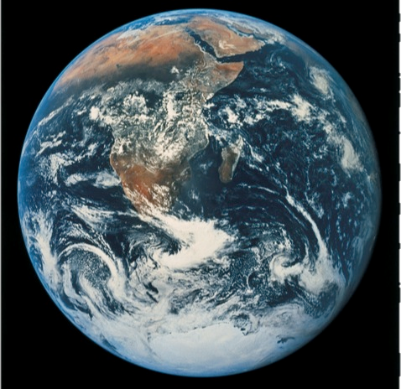
The effects of overpopulation depend on the ratio of population to sustainable resources
Notes:
Current projections—incorporating projected declines in growth rates—still predict a global population somewhere between 8 and 10.5 billion by the year 2050.¹ The effects of overpopulation depend on the ratio of population to sustainable resources, as well as on the distribution of such resources, including clean water, clean air, food, shelter, and appropriate climatic conditions.

Slide 10
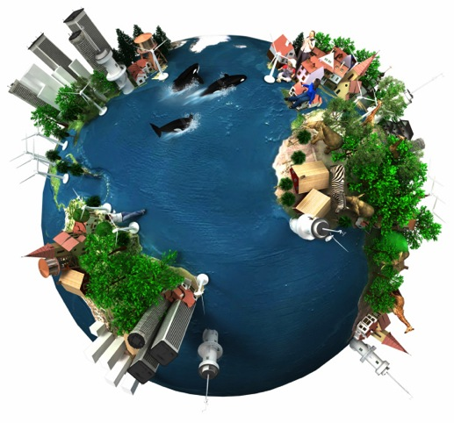
Overpopulation often damages a nation’s economy
Notes:
Overpopulation often damages a nation’s economy. When a country is unable to feed its population, it consequently has to purchase and import food. People take up space needed for farms and forests; their waste pollutes the water, land, and air. Destruction of forests results in loss of animal habitats as well as loss of plant species and their capacity to remove carbon dioxide and produce oxygen. Overpopulation presents serious difficulties to effective governance and stress; consequently, strife and turmoil often ensue.

Slide 11
Number of children born per woman
Continent/Region | Numbers
Europe | 2.66 to 1.41
North America | 3.47 to 1.99
Oceania | 3.87 to 2.30
Central America | 6.38 to 2.66
South America | 5.75 to 2.49
Asia | 5.85 to 2.43
Middle East and North America | 6.99 to 3.37
Sub-Saharan Africa | 6.70 to 5.53
Notes:
Between 1950 and 2005, the number of children born per woman decreased from 5.02 to 2.65, though even at this rate the global population continues to expand. By continent, the numbers (for 1950 to 2005) are seen in the table:² Even at a single child per couple the population is calculated to reach 10 billion before it would begin to decline.

Slide 12
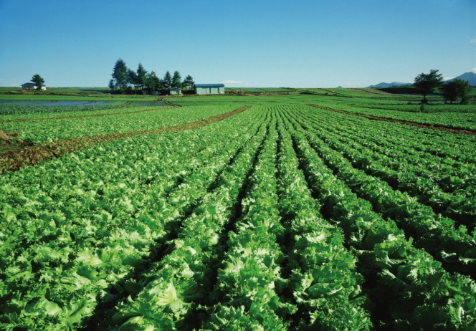
Sustainable agriculture
Notes:
Closely related to overpopulation is the issue of sustainable agriculture. Improvements in agricultural technology have led to enormous increases in yields of produce per acre of land utilized. Such improvements, however, do not come without an environmental cost. Further changes in agricultural priorities are needed to balance the utilization of land.

Slide 13

Deforestation on a massive scale often results in damage to the quality of the land
Notes:
Deforestation on a massive scale often results in damage to the quality of the land. Although some 30 percent of the earth’s surface is still covered by forest, large tracts of land are lost annually to deforestation.

Slide 14
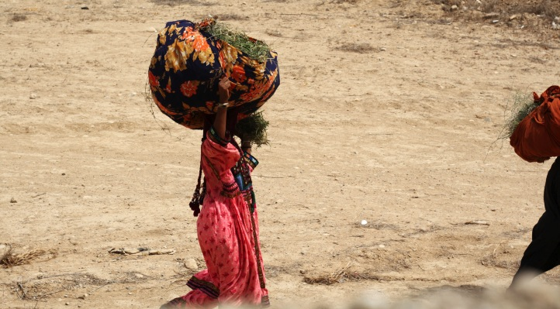
The balance between our need for forests and our need for food relates to the pressures of overpopulation.
Notes:
The balance between our need for forests and our need for food relates to the pressures of overpopulation. Deforestation contributes to climate change. Moist forest soils quickly dry out without the shade of a forest canopy. Forest lands can quickly become deserts. The role played by forests in absorbing greenhouse gases is a central one.³

Slide 15
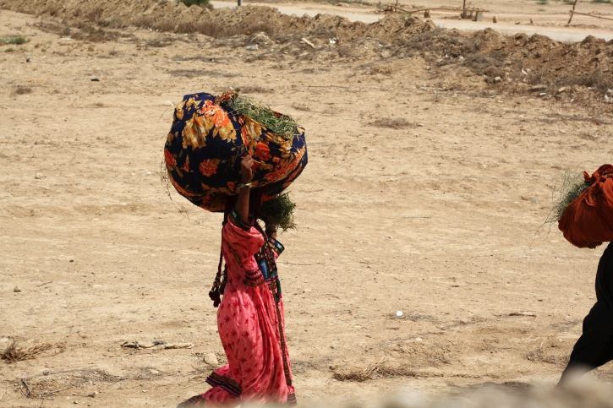
Food is not freely available to all
Notes:
The uneven development of the world means that although current food production is sufficient for the global population, food is not freely available to all. Poverty and the impact of climate change are felt much more acutely where drought and desertification are taking place. Many undeveloped countries have an inadequate infrastructure to permit the proper distribution of food.

Slide 16
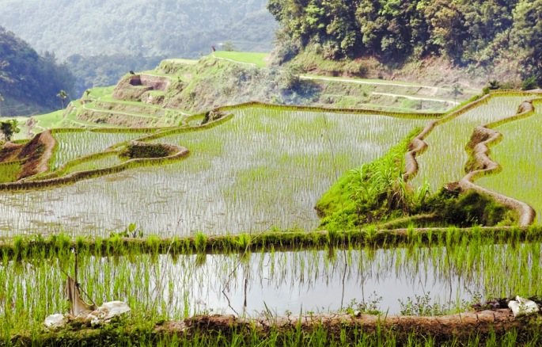
Climate change
Notes:
Most scientists agree that there have been significant warming changes during the last 100 years, though opinions differ as to why.
Climate change may influence food production. Yields of grain have been shown in many situations to vary with temperatures. For example, the International Rice Research Institute in the Philippines⁴ found that rice production declined by 10 percent for each 1-degree-centigrade increase in growing season nighttime-minimum temperature.
Researchers Lobell and Field⁵ reported that climate changes since 1981 have resulted in annual losses of wheat, maize, and barley, representing roughly a combined loss of $5 billion per year as of 2002. This is not a sizable amount, however, relative to the value of improved yields resulting from technological change.

Slide 17
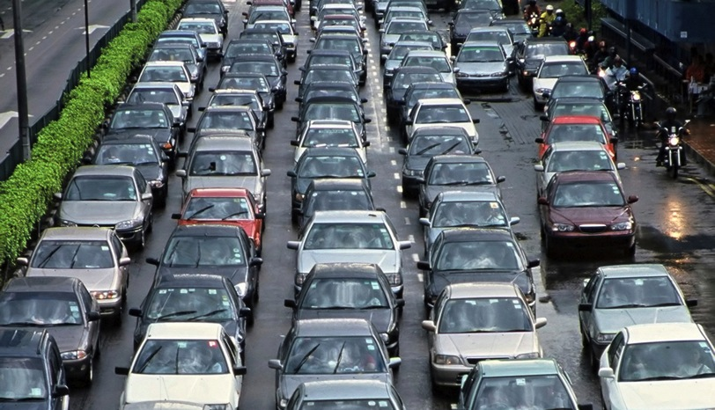
Energy conservation is an important part of environment preservation. 34
Notes:
Reliance upon fossil fuels has characterized much of the energy utilization during the past century. It’s likely that the increased cost of such energy will drive the move to alternate energy sources. Regardless of cost issues, energy conservation is an important part of environment preservation.

Slide 18
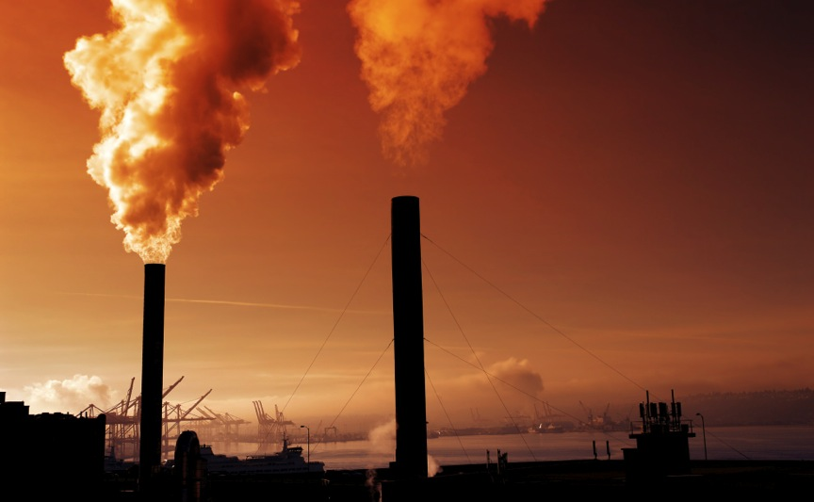
Water and air pollution
Notes:
Two areas of pollution that are particularly concerning are water and air pollution.
Industrialization has produced massive amounts of collateral waste material. The seriousness of environment contamination by pollutants varies with the elements involved. Plastics are derivatives of petroleum-type products, and while extremely useful, they do not naturally degrade easily. It’s been shown that plastic can persist for multiple decades. Even when mixed with cellulose to produce so-called “biodegradable plastic,” the actual plastic particles remain much longer than the cellulose, which degrades. Remaining plastic particles, if small enough, may be subject to bacterial degradation. In practice, such degradation does not always occur as predicted. The state of California sued a plastic bottle maker—ENSO Plastics, Aquamantra and Balance Water—for false claims.⁶

Slide 19
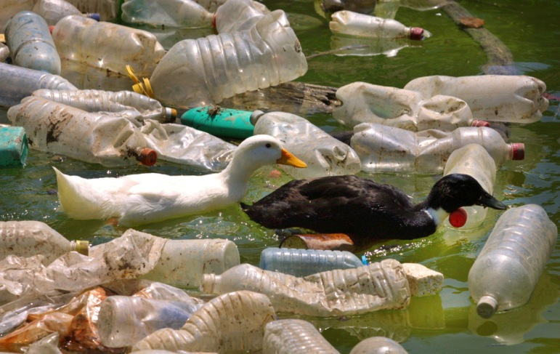
Fragmented plastic eventually finds its way into the ocean
Notes:
Sun, wind, and wave action merely fragment plastic, but eventually most of it finds its way into the ocean. Scientists have discovered plastic particulate matter at a depth of 15 to 30 feet in the Pacific Ocean. These particles, called “nurdles,” have been found in the digestive tracts of krill, which are the ocean’s basic food source for most marine life. Our addiction to disposable plastic water bottles may pose a huge threat to the planet.⁷
Industrial waste—which includes heavy metals such as lead, mercury, and cadmium, as well as the toxic dioxin compounds—can be particularly dangerous and is contaminating the underground water. The radioactive contamination following the 2011 earthquake and massive tsunami off the coast of Japan will likely render the Fukushima area uninhabitable for decades, if not centuries. The Chernobyl disaster in Ukraine in 1986 resulted in increases in thyroid and other cancers. Radioactive isotopes leached into the water are a form of silent yet lethal pollution.

Slide 20
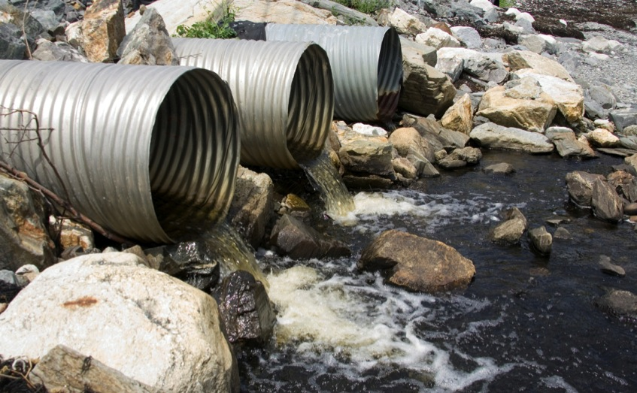
Hygiene is a fundamental health principle
Notes:
Outbreaks of disease frequently are related to viral and bacterial contamination by human and animal waste. Hygiene is a fundamental health principle.

Slide 21
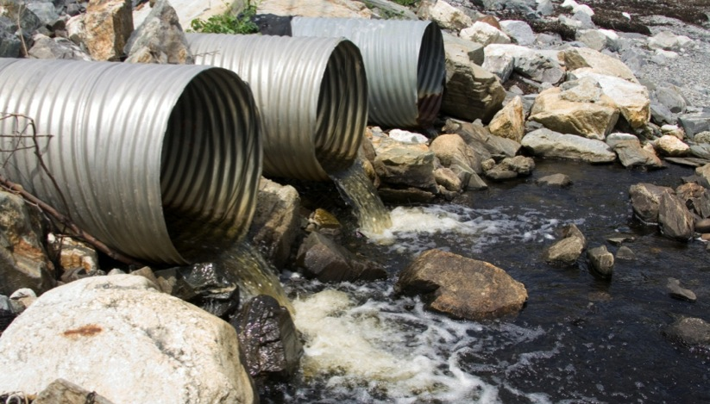
Polluted regions may not have immediate health problems
Notes:
The Blacksmith Institutes Technical Advisory Board⁸ reports that persons living in polluted regions may not have immediate health problems, but may later develop cancers, lung infections, and mental retardation.

Slide 22

Children’s asthma rates have increased
Notes:
There are towns in various parts of the world where life expectancy currently approaches low medieval rates, and where birth defects are the norm rather than the exception. In other places, children’s asthma rates have been measured above 90 percent. In these regions, life expectancy may be half that of the richest nations. In North America, it’s estimated that half the population is affected by some form of dangerous pollution levels.
The American Lung Association⁹ estimates that roughly 50 percent of Americans live in counties that have unhealthful levels of either ozone or pesticide pollution. The University of Southern California¹° has studied residents in 12 communities within a 200-mile radius of Los Angeles. They have followed three groups of children within these communities and quite convincingly have shown interference with lung growth in those who live in more polluted atmospheric conditions. Such children are at increased risk of bronchial and pulmonary disease. Follow-up studies have confirmed these findings.

Slide 23

Solar irradiation
Notes:
The sun is central to the provision of energy to our planet. Much of its radiation is important to well-being, but overexposure to ultraviolet radiation can be harmful. Such radiation may be stronger should the ozone layers of the upper atmosphere be depleted.
Sunshine maintains the ambient temperature of the earth; it promotes photosynthesis, which is the fundamental food-producing mechanism. Sunlight powers the recycling of water through evaporation of water into the clouds, and its distillation as rain.

Slide 24

An appropriate amount of sunshine depends on the pigment of our skin
Notes:
Sunshine also converts an inactive form of vitamin D called cholecalciferol into the active form of vitamin D we need for so many bodily functions. While some of us live in situations of adequate sunlight, many of us work indoors and do not get sufficient exposure to the sun. Darkly pigmented skin does not permit the effect of sunlight to the same extent as pale skin, so vitamin D levels may be lower in such people, especially when they live in extreme northern or southern climes.
Dermatologists have noted the association between sunburn and skin cancer, and advocate the avoidance of overexposure. An appropriate amount depends on the pigmentation of our skin, our geographic location, and the season.

Slide 25

Vitamin D is probably an important factor…
Notes:
On the other hand, vitamin D is probably an important factor in controlling the growth of other cancers, such as prostate cancer. Sunlight exposure, therefore, in an appropriate amount, is essential to health.¹¹ It kills many bacteria, and it’s a healthful practice to let the sunlight stream into our homes.
Sunlight also stimulates the production of serotonin. This is an example of the “external” environment influencing our “internal” environment. The Seasonal Affective Disorder (SAD) first described in 1984 by Dr. Norman Rosenthal, a neuropsychiatrist at the National Institute of Mental Health, affects many during the winter months when light is diminished. Such people suffer a loss of energy, alteration in appetite, somnolence (drowsiness), irritability, and depression.¹² They will benefit by exposure to bright light.

Slide 26

Internal environment
Notes:
Although we live in an external environment, our metabolic processes take place in an internal environment.
Our bodies maintain a precise balance—or equilibrium—through the processes of homeostasis. We best support homeostasis by a life that includes daily physical activity and a healthful diet rich in unrefined plant foods.

Slide 27

We must not introduce toxins into our bodies
Notes:
We must be extremely careful not to introduce toxins of overt and dangerous action into our bodies’ internal environment. Tobacco smoke, with its hundreds of chemicals, is a prime example. Alcohol also is a potent toxin. The use of psychotropic drugs (medications that affect the central nervous system and can cause changes in behavior or perception) as “recreational” substances intoxicates our internal environment, as well.
Many substances have never been tested or properly evaluated, yet are touted as being good for one or another condition. Without evidence, we use them in a vacuum of knowledge. Many so-called “natural” substances of herbal or plant origin fall into such categories and are best avoided.

Slide 28
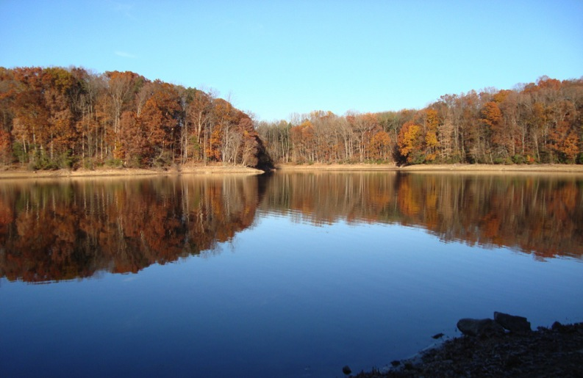
We are stewards of the earth
Notes:
Health, God’s gift to us, is best maintained in the most natural state of unpolluted and hygienic purity. We are stewards of the earth, responsible for managing the earth’s resources and the environment of our bodies.

Slide 29

Too many homes are places of tension
Notes:
Because we are more than mere physical beings and possess intellectual, emotional, and spiritual dimensions, we also need to consider the emotional and spiritual environments in which we live. Too many homes are places of tension and distrust. Anger and violence in the home will take an enormous toll on the health of our children and ourselves.
Domestic violence affects many of our homes; verbal abuse also is common. Our homes should provide an oasis of security in a world of turmoil. Kind and supportive attitudes will nurture the emotional health of the family.

Slide 30

The spiritual environment of the home affects the environment of our minds
Notes:
The spiritual environment of the home affects the environment of our minds. Our homes should be calm, comforting, and supportive places. Values are taught and come from a basis of belief and trust. We place our trust in a loving God. We are secure in His care and teach our children to seek this spiritual relationship with Him. We urge them to be loving and nonjudgmental of others. God admonishes us to love our enemies, and to do good to those who might mistreat us.¹³
If we live in an atmosphere of tolerance and peace, our spiritual environment will also be conducive to health. We will, as it were, drink at a fountain of life. The atmosphere of heaven will comfort our souls. We will be secure as we ground ourselves in the certainty of God’s love.

Slide 31

LIFE APPLICATION QUESTIONS
Notes:
LIFE APPLICATION QUESTIONS

Slide 32

Even though I sometimes feel as though one person cannot do much to stop deforestation and industrial pollution, besides financially supporting some protest groups…
Notes:
Even though I sometimes feel as though one person cannot do much to stop deforestation and industrial pollution, besides financially supporting some protest groups…

Slide 33
…what choices can I make, such as the ways I use energy and plastics, that will contribute even in a small way to protecting the environment?
Notes:
…what choices can I make, such as the ways I use energy and plastics, that will contribute even in a small way to protecting the environment?

Slide 34

Shawn has a “green” friend who is highly vocal about environmental issues, but she’s skeptical of Shawn’s choice to be a vegetarian.
Notes:
Shawn has a “green” friend who is highly vocal about environmental issues, but she’s skeptical of Shawn’s choice to be a vegetarian.

Slide 35
Which advantages of a vegetarian diet could Shawn point out that would meet with her friend’s approval as an environmentalist?
Notes:
Which advantages of a vegetarian diet could Shawn point out that would meet with her friend’s approval as an environmentalist?

Slide 36

Education can often lead to more informed choices about family size population growth and better quality of life and health to all.
Notes:
Education can often lead to more informed choices about family size population growth and better quality of life and health to all.

Slide 37
What can I do to support the efforts of groups that run educational institutions and programs in countries where poverty drastically reduces the quality of life for many families?
Notes:
What can I do to support the efforts of groups that run educational institutions and programs in countries where poverty drastically reduces the quality of life for many families?

Slide 38

Have I experienced any of the Seasonal Affective Disorder (SAD) symptoms, such as depression and irritability in the winter months, or when spending time indoors?
Notes:
Have I experienced any of the Seasonal Affective Disorder (SAD) symptoms, such as depression and irritability in the winter months, or when spending time indoors?

Slide 39

How can I change my program in order to spend a carefully regulated amount of time in the sunshine?
Notes:
How can I change my program in order to spend a carefully regulated amount of time in the sunshine?

Slide 40

Are there children in my community or family that need encouragement to spend time outdoors, or who need caution to limit their exposure to too much sunshine?
Notes:
Are there children in my community or family that need encouragement to spend time outdoors, or who need caution to limit their exposure to too much sunshine?

Slide 41

Which pollutants are my body being exposed to?
Which of these can I limit or eliminate altogether?
Notes:
Which pollutants are my body being exposed to? Which of these can I limit or eliminate altogether?

Slide 42
Are some of my choices exposing me to chemicals or substances that might give me passing gratification but have harmful effects in the long-term?
Notes:
Are some of my choices exposing me to chemicals or substances that might give me passing gratification but have harmful effects in the long-term?

Slide 43

How am I contributing emotionally and spiritually to the following environments: home, work, school, church, community?
What type of contribution am I making?
Notes:
How am I contributing emotionally and spiritually to the following environments: home, work, school, church, community? What type of contribution am I making?

Slide 44

Is it causing pollution or peace, strife or sanctuary?
What choices can I make, and where can I receive the help I need to stick to my decision to improve and protect my environment?
Notes:
Is it causing pollution or peace, strife or sanctuary? What choices can I make, and where can I receive the help I need to stick to my decision to improve and protect my environment?

